Slide 1
51
Discrete Mathematics
Greatest Common Divisors as Linear Combinations

Slide 2









Slide 3




Slide 4
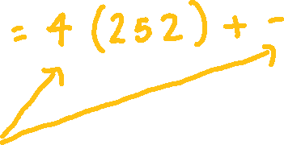












Slide 5
Up Next…
Solving Linear Congruences Using the Inverse

